Slide 1



DCLab/Control System Crash Course
Power Architecture
and ADC
4S BATTERY / 12–16.8 V
5 V
LOGIC
6 V
MOTORS
Dual Buck Calibration and
Analog Battery Sensing
REGULATE / MEASURE / FILTER
Session 03
DCLab/Control System Crash Course
01
>_ terminal gremlin (c-lydia ^_^)
Notes:
Session 03. Based on Power Architecture, Dual Buck Calibration, and Analog Battery Sensing.pdf. Style inherited from Session 02 and the shared DC Lab template.

Slide 2
00 / Contents
Contents
01
Power Architecture
Separate supply rails and shared return paths
02
Buck Calibration
Set and verify the 5 V and 6 V outputs
03
Analog Sensing
Scale, convert, and filter battery voltage
04
Implementation
Integrate firmware, measure, and debug
Source: course PDF, pp. 1–19
DCLab/Control System Crash Course
02
>_ terminal gremlin (c-lydia ^_^)
Notes:
Reference: Power Architecture, Dual Buck Calibration, and Analog Battery Sensing.pdf, pages 1–19.

Slide 3
01 / Power Architecture
One Battery, Two Different Loads
Digital logic
ESP32 and sensors need a stable supply
for computation, sensing, and communication.
Motor drive
Starting, reversing, and stalling motors
produce large changes in current demand.
Shared supply risk
Voltage sag and ground bounce can disturb
measurements or cause the MCU to reset.
Design the power path around the load behavior.
Source: course PDF, pp. 1–2
DCLab/Control System Crash Course
03
>_ terminal gremlin (c-lydia ^_^)
Notes:
Reference: Power Architecture, Dual Buck Calibration, and Analog Battery Sensing.pdf, pages 1–2.

Slide 4
01 / Power Architecture
Why Motor Startup Can Reset the MCU
Current step
Starting or stalling a motor increases current
through the battery and shared wiring.
Voltage drop
Battery resistance and connection impedance
turn that current step into supply voltage sag.
Logic consequence
If the MCU supply drops too far, operation
becomes unreliable and a reset may occur.
Two regulators reduce coupling; they do not remove shared-path impedance.
Source: course PDF, pp. 1–2
DCLab/Control System Crash Course
04
>_ terminal gremlin (c-lydia ^_^)
Notes:
Reference: Power Architecture, Dual Buck Calibration, and Analog Battery Sensing.pdf, pages 1–2.

Slide 5
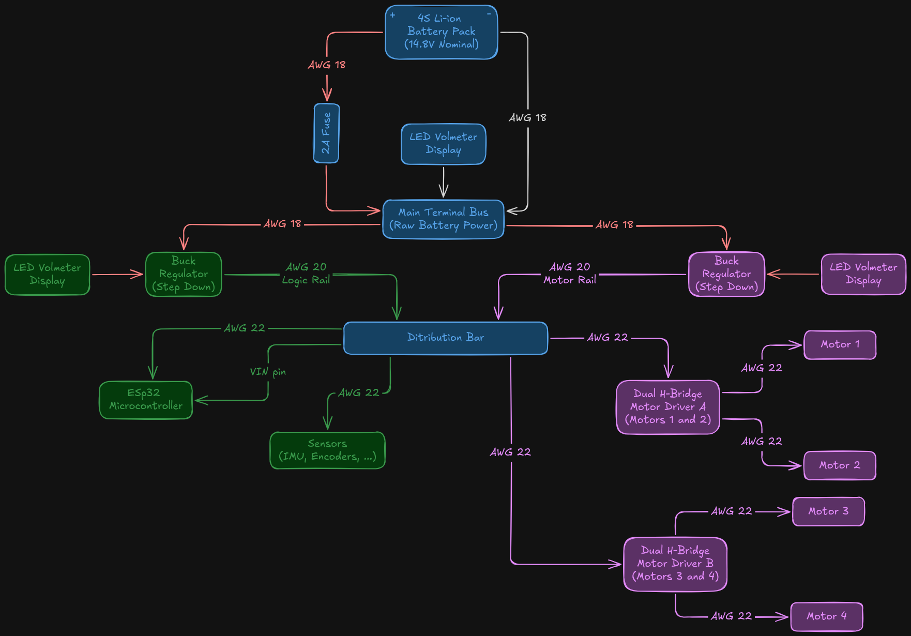
01 / Power Architecture
Power Architecture: Original Overview
FOLLOW THE POWER
Battery → fuse → bus
Two buck branches
Logic and motor loads
The distribution assembly carries separate 5 V and 6 V positive rails.
Source: course PDF, pp. 1
DCLab/Control System Crash Course
05
>_ terminal gremlin (c-lydia ^_^)
Notes:
Reference: Power Architecture, Dual Buck Calibration, and Analog Battery Sensing.pdf, pages 1.

Slide 6
01 / Power Architecture
Trace Each Power Rail
Battery bus
The fused battery positive feeds both buck
inputs; raw battery voltage is 12–16.8 V.
5 V logic rail
Buck 1 supplies ESP32 VIN and suitable
5 V loads. It does not connect to the 3V3 pin.
6 V motor rail
Buck 2 supplies driver VM in this course
example; check the actual motor voltage rating.
Keep the two positive outputs separate; connect their returns to the ground bus.
Source: course PDF, pp. 1–2
DCLab/Control System Crash Course
06
>_ terminal gremlin (c-lydia ^_^)
Notes:
Reference: Power Architecture, Dual Buck Calibration, and Analog Battery Sensing.pdf, pages 1–2.

Slide 7
01 / Power Architecture
The 4S Battery Operating Range
FULLY CHARGED
NOMINAL
LAB THRESHOLD
16.8 V
14.8 V
12.0 V
4 × 4.2 V
Maximum pack voltage.
4 × 3.7 V
Nominal rating, not a
constant voltage.
4 × 3.0 V
Pack-level low-voltage
warning threshold.
Pack voltage alone does not reveal individual cell imbalance.
Source: course PDF, pp. 2
DCLab/Control System Crash Course
07
>_ terminal gremlin (c-lydia ^_^)
Notes:
Reference: Power Architecture, Dual Buck Calibration, and Analog Battery Sensing.pdf, pages 2.
Threshold follows the course example; suitable cell-level protection and charging must match the actual pack. Do not interpret 12 V as a universal 0% state of charge.

Slide 8



01 / Power Architecture
Four Cells in Series: Voltage Adds
4S1P means four cells in series and one parallel string.
Source: course PDF, pp. 2
DCLab/Control System Crash Course
08
>_ terminal gremlin (c-lydia ^_^)
Notes:
Reference: Power Architecture, Dual Buck Calibration, and Analog Battery Sensing.pdf, pages 2.

Slide 9


01 / Power Architecture
Buck Regulator Input Headroom
This is the course headroom example; verify the actual module under load.
Source: course PDF, pp. 2
DCLab/Control System Crash Course
09
>_ terminal gremlin (c-lydia ^_^)
Notes:
Reference: Power Architecture, Dual Buck Calibration, and Analog Battery Sensing.pdf, pages 2.

Slide 10
01 / Power Architecture
Protection and Return Paths
Fuse near battery
The reference uses a 2 A inline fuse.
Confirm its rating against wiring and load demand.
Star ground
Return high motor currents directly to the
main terminal bus using suitable heavy wire.
Logic wiring
Keep motor current out of breadboard tracks
and thin logic jumpers; use local decoupling.
A fuse limits fault energy; its clearing time depends on fault current.
Source: course PDF, pp. 2–3
DCLab/Control System Crash Course
10
>_ terminal gremlin (c-lydia ^_^)
Notes:
Reference: Power Architecture, Dual Buck Calibration, and Analog Battery Sensing.pdf, pages 2–3.
The PDF’s universal millisecond clearing and guaranteed fire-prevention claims are not repeated. 2 A is a reference design value, not a substitute for load and fuse-curve verification.

Slide 11
01 / Power Architecture
Fuse and Star Bus: Physical Placement
Battery positive
Place the reference 2 A fuse near the battery
before the main positive distribution terminal.
Battery negative
Use the main negative terminal as the
common reference for the return branches.
Motor return
Run suitable heavy wire from the drivers
to the bus; do not pass it through logic wiring.
Reference wiring uses AWG 18 for the main feed and AWG 18–20 for returns.
Source: course PDF, pp. 2–3
DCLab/Control System Crash Course
11
>_ terminal gremlin (c-lydia ^_^)
Notes:
Reference: Power Architecture, Dual Buck Calibration, and Analog Battery Sensing.pdf, pages 2–3.

Slide 12
02 / Buck Calibration
Before Applying Power
Disconnect loads
Keep ESP32 VIN and motor-driver VM
disconnected until both rails are adjusted.
Inspect + measure
With power OFF, verify polarity, fuse,
ground continuity, and no persistent rail short.
Identify outputs
Label Buck 1 = 5 V and Buck 2 = 6 V.
Use adjustable modules for these setpoints.
Use resistance and continuity modes only on an unpowered circuit.
Source: course PDF, pp. 7
DCLab/Control System Crash Course
12
>_ terminal gremlin (c-lydia ^_^)
Notes:
Reference: Power Architecture, Dual Buck Calibration, and Analog Battery Sensing.pdf, pages 7.
Corrects the duplicated Buck 2 label and the contradictory fixed-output buck symbols in the PDF. Use adjustable converter modules with appropriate input/current ratings.

Slide 13
02 / Buck Calibration
Measure the Battery Before Adjustment
Meter mode
Select DC voltage; use a range above the
maximum pack voltage of 16.8 V.
Probe placement
Black probe → main negative terminal.
Red probe → fused battery-positive bus.
Cross-check
Read the meter and the battery display.
The course comparison target is ±0.10 V.
Confirm a positive reading and correct polarity before adjusting either buck.
Source: course PDF, pp. 7
DCLab/Control System Crash Course
13
>_ terminal gremlin (c-lydia ^_^)
Notes:
Reference: Power Architecture, Dual Buck Calibration, and Analog Battery Sensing.pdf, pages 7.

Slide 14
02 / Buck Calibration
Calibrate Buck 1: The 5 V Logic Rail
Disconnect loads
Leave ESP32 VIN and the logic loads
disconnected during initial adjustment.
Measure output
Probe OUT+ relative to OUT− on Buck 1.
Keep the probes clear of neighboring terminals.
Adjust + compare
Turn the trimmer while watching the meter.
Set 5.00 V and compare the 5 V display.
Use the meter as the reference; trimmer direction depends on the module.
Source: course PDF, pp. 7
DCLab/Control System Crash Course
14
>_ terminal gremlin (c-lydia ^_^)
Notes:
Reference: Power Architecture, Dual Buck Calibration, and Analog Battery Sensing.pdf, pages 7.

Slide 15
02 / Buck Calibration
Calibrate Buck 2: The 6 V Motor Rail
Disconnect drivers
Keep motor-driver VM disconnected
while setting the output voltage.
Measure output
Probe Buck 2 OUT+ relative to OUT−.
Adjust carefully until the meter reads 6.00 V.
Label + verify
Compare the motor-rail display and label
the output before reconnecting the driver.
After reconnecting, check the output during startup and normal motor loading.
Source: course PDF, pp. 7
DCLab/Control System Crash Course
15
>_ terminal gremlin (c-lydia ^_^)
Notes:
Reference: Power Architecture, Dual Buck Calibration, and Analog Battery Sensing.pdf, pages 7.

Slide 16
02 / Buck Calibration
Verify Before Connecting the Loads
Power OFF
Verify that 5 V and 6 V positives are not
accidentally tied together; grounds are shared.
Reconnect
Connect each load to its labeled rail.
Recheck polarity before applying power.
Power ON
Measure both rails under load and during
motor startup; investigate sag or overheating.
A resistance reading alone does not prove electrical isolation.
Source: course PDF, pp. 7–9
DCLab/Control System Crash Course
16
>_ terminal gremlin (c-lydia ^_^)
Notes:
Reference: Power Architecture, Dual Buck Calibration, and Analog Battery Sensing.pdf, pages 7–9.
The PDF asks for >100 kΩ between rails as proof of isolation. These non-isolated buck modules share ground; internal paths and capacitors affect resistance readings. Check wiring and outputs instead.

Slide 17
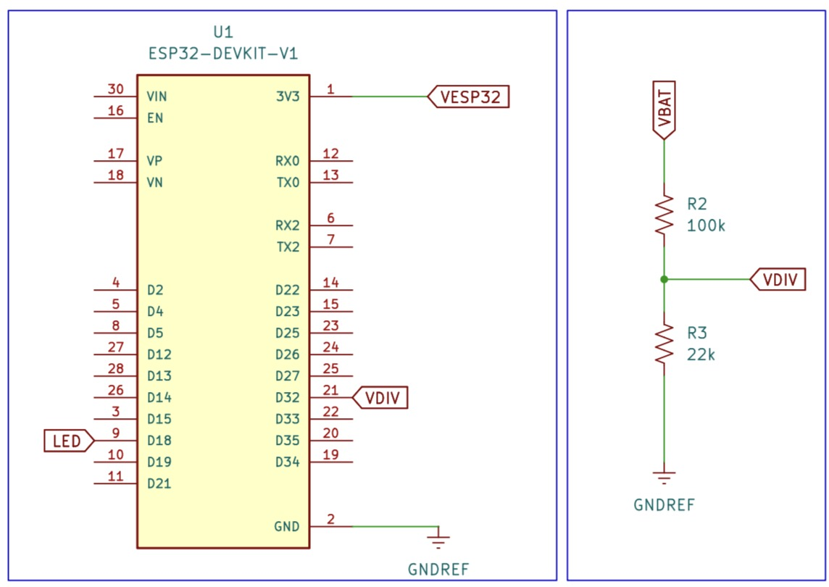

03 / Analog Battery Sensing
Resistive Divider: Circuit and Equation
VDIV is the midpoint connected to GPIO 32.
R2 is above VDIV; R3 is below it.
Use top/bottom names in the calculations; the schematic labels these R2 and R3.
Source: course PDF, pp. 3–5, 8
DCLab/Control System Crash Course
17
>_ terminal gremlin (c-lydia ^_^)
Notes:
Reference: Power Architecture, Dual Buck Calibration, and Analog Battery Sensing.pdf, pages 3–5, 8.

Slide 18



03 / Analog Battery Sensing
Calculate the Divider Ratio
The ADC receives about 18.03% of the battery voltage.
Source: course PDF, pp. 4–5
DCLab/Control System Crash Course
18
>_ terminal gremlin (c-lydia ^_^)
Notes:
Reference: Power Architecture, Dual Buck Calibration, and Analog Battery Sensing.pdf, pages 4–5.

Slide 19


03 / Analog Battery Sensing
Check the Divider at Both Limits
Measure the assembled midpoint before connecting it to the ADC.
Source: course PDF, pp. 5
DCLab/Control System Crash Course
19
>_ terminal gremlin (c-lydia ^_^)
Notes:
Reference: Power Architecture, Dual Buck Calibration, and Analog Battery Sensing.pdf, pages 5.

Slide 20

03 / Analog Battery Sensing
Divider Current and ADC Headroom
1% tolerance example: top −1%, bottom +1%. Check the actual ADC input range.
Source: course PDF, pp. 5
DCLab/Control System Crash Course
20
>_ terminal gremlin (c-lydia ^_^)
Notes:
Reference: Power Architecture, Dual Buck Calibration, and Analog Battery Sensing.pdf, pages 5.

Slide 21
03 / Analog Battery Sensing
Choose an ADC1 Input
GPIO 32
ADC1 channel 4; a general-purpose I/O.
Configure it as an input for battery sensing.
GPIO 34
ADC1 channel 6; input-only.
No internal pull-up or pull-down resistor.
Wi-Fi coexistence
Prefer ADC1 for this classic ESP32 design.
ADC2 is shared with the Wi-Fi subsystem.
Pin mappings differ across ESP32 variants; check the actual board.
Source: course PDF, pp. 5
DCLab/Control System Crash Course
21
>_ terminal gremlin (c-lydia ^_^)
Notes:
Reference: Power Architecture, Dual Buck Calibration, and Analog Battery Sensing.pdf, pages 5.
Correction: GPIO32 is not input-only. Official GPIO reference: https://docs.espressif.com/projects/arduino-esp32/en/latest/api/gpio.html

Slide 22
03 / Analog Battery Sensing
ADC Resolution and Input Range
RESOLUTION
ATTENUATION
PRACTICAL CHECK
12 bits
ADC_11db
3.030 V
2¹² = 4096 levels
Raw codes: 0–4095.
Classic ESP32 documented
range: about 0.15–3.10 V.
Check device variant.
The nominal full-pack
divider voltage is close
to the top of this range.
Resolution, measurable range, and accuracy are different properties.
Source: course PDF, pp. 5–6
DCLab/Control System Crash Course
22
>_ terminal gremlin (c-lydia ^_^)
Notes:
Reference: Power Architecture, Dual Buck Calibration, and Analog Battery Sensing.pdf, pages 5–6.
Corrects 4086 to 4096. The 3.3 V ideal conversion in the PDF is not a calibrated ESP32 transfer function. Verify resistor tolerance and usable range. Official ADC reference: https://docs.espressif.com/projects/arduino-esp32/en/latest/api/adc.html

Slide 23

03 / Analog Battery Sensing
Quantization: The Ideal 3.3 V Model
An ideal 12-bit quantizer has 4096 bins; this is not an ESP32 calibration model.
Source: course PDF, pp. 5–6
DCLab/Control System Crash Course
23
>_ terminal gremlin (c-lydia ^_^)
Notes:
Reference: Power Architecture, Dual Buck Calibration, and Analog Battery Sensing.pdf, pages 5–6.

Slide 24


03 / Analog Battery Sensing
Undo the Divider: Reconstruct Voltage
Firmware reads calibrated millivolts, then applies the external divider ratio.
Source: course PDF, pp. 6, 11–12
DCLab/Control System Crash Course
24
>_ terminal gremlin (c-lydia ^_^)
Notes:
Reference: Power Architecture, Dual Buck Calibration, and Analog Battery Sensing.pdf, pages 6, 11–12.

Slide 25

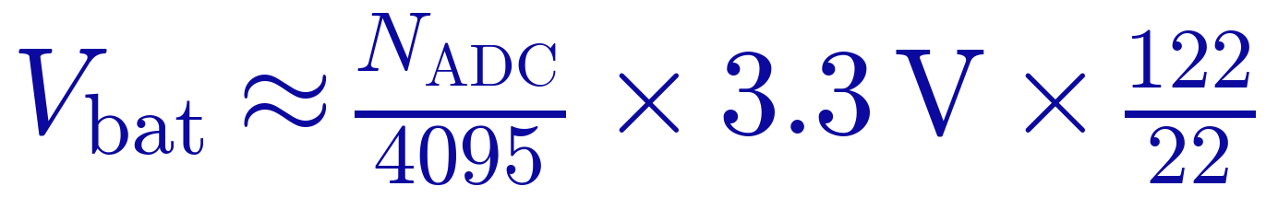
03 / Analog Battery Sensing
Raw Counts: The Course Endpoint Approximation
Dividing by 4095 maps both endpoints; it differs from the 4096-bin quantization step.
Source: course PDF, pp. 6
DCLab/Control System Crash Course
25
>_ terminal gremlin (c-lydia ^_^)
Notes:
Reference: Power Architecture, Dual Buck Calibration, and Analog Battery Sensing.pdf, pages 6.

Slide 26
03 / Analog Battery Sensing
Why Raw Voltage Readings Move
Switching ripple
Buck converters inject switching components
onto the supply and ground network.
Motor transients
Commutation and changing load current cause
spikes, voltage sag, and ground bounce.
Measurement chain
ADC noise, divider tolerances, and wiring
add variation to the sampled voltage.
Improve wiring first; filtering cannot repair a bad electrical connection.
Source: course PDF, pp. 6
DCLab/Control System Crash Course
26
>_ terminal gremlin (c-lydia ^_^)
Notes:
Reference: Power Architecture, Dual Buck Calibration, and Analog Battery Sensing.pdf, pages 6.

Slide 27
03 / Analog Battery Sensing
Exponential Moving Average (EMA)
x[k]: new sample; y[k − 1]: previous result; y[k]: updated result.
Source: course PDF, pp. 6–7, 12
DCLab/Control System Crash Course
27
>_ terminal gremlin (c-lydia ^_^)
Notes:
Reference: Power Architecture, Dual Buck Calibration, and Analog Battery Sensing.pdf, pages 6–7, 12.

Slide 28
03 / Analog Battery Sensing
Work Through One Filter Update
Worked example: one low sample moves the filtered value by only 0.09 V.
Source: course PDF, pp. 6–7, 12
DCLab/Control System Crash Course
28
>_ terminal gremlin (c-lydia ^_^)
Notes:
Reference: Power Architecture, Dual Buck Calibration, and Analog Battery Sensing.pdf, pages 6–7, 12.

Slide 29
03 / Analog Battery Sensing
Choose the Smoothing Coefficient
α = 1.00
α = 0.15
α = 0.01
Fast / noisy
Lab starting point
Slow / smooth
Output equals the
newest sample.
No smoothing.
Balances smoothing
and responsiveness at
the 10 Hz sample rate.
Strong smoothing
with substantial lag
after voltage changes.
The response depends on both α and the sampling interval.
Source: course PDF, pp. 6–7
DCLab/Control System Crash Course
29
>_ terminal gremlin (c-lydia ^_^)
Notes:
Reference: Power Architecture, Dual Buck Calibration, and Analog Battery Sensing.pdf, pages 6–7.

Slide 30
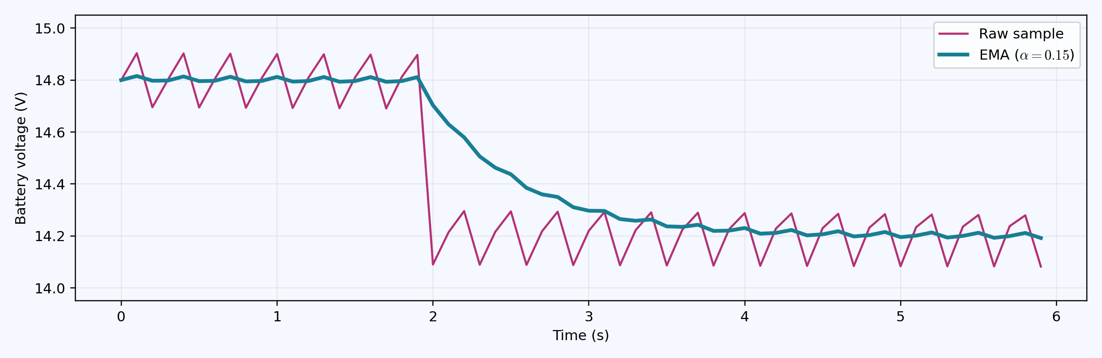
03 / Analog Battery Sensing
See the Effect of the Filter
Illustrative 10 Hz samples: smoothing reduces variation but adds response lag.
Source: course PDF, pp. 6–7
DCLab/Control System Crash Course
30
>_ terminal gremlin (c-lydia ^_^)
Notes:
Reference: Power Architecture, Dual Buck Calibration, and Analog Battery Sensing.pdf, pages 6–7.

Slide 31
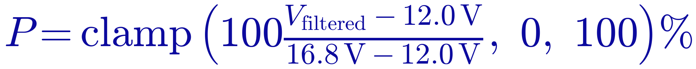
03 / Analog Battery Sensing
Battery Percentage and Low Voltage
This is a voltage indicator, not true state of charge; the code reports a warning.
Source: course PDF, pp. 12–15
DCLab/Control System Crash Course
31
>_ terminal gremlin (c-lydia ^_^)
Notes:
Reference: Power Architecture, Dual Buck Calibration, and Analog Battery Sensing.pdf, pages 12–15.

Slide 32
04 / Implementation
Connect the Measurement Chain
Power
Buck 1 → ESP32 VIN / suitable 5 V loads.
Buck 2 → motor-driver VM terminals.
Sense
Battery → 100 kΩ → GPIO 32 midpoint.
Midpoint → 22 kΩ → common ground.
Outputs + serial
GPIO 18: PWM; GPIO 4: heartbeat LED.
Use current limiting for LEDs; serial: 115200 baud.
Keep the 5 V and 6 V rails separate and verify the board power input.
Source: course PDF, pp. 8–10, 15–17
DCLab/Control System Crash Course
32
>_ terminal gremlin (c-lydia ^_^)
Notes:
Reference: Power Architecture, Dual Buck Calibration, and Analog Battery Sensing.pdf, pages 8–10, 15–17.
Check the development board’s USB/external-power arrangement before connecting both. Schematic symbols in the source conflict with the 5 V VIN text; this deck consistently follows the course’s 5 V VIN architecture.

Slide 33
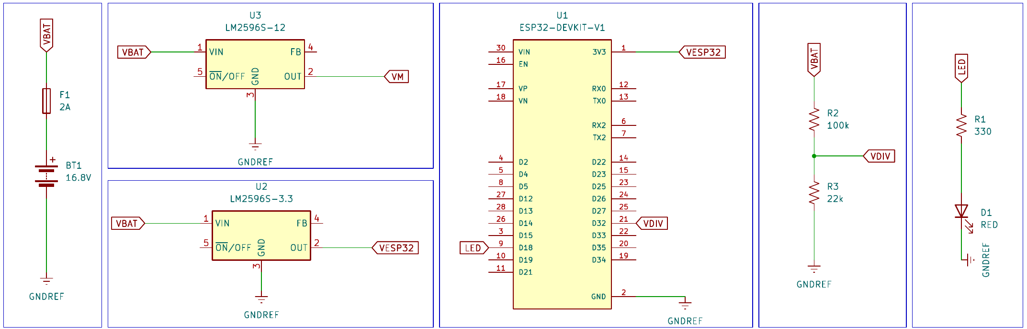
04 / Implementation
Power System: Full Reference Schematic
Original 3.3 V / 12 V drawing; the lab uses 5 V → VIN and a separate motor rail.
Read VBAT, VM, VDIV, LED, and GNDREF as connected nets across the sheet.
Source: course PDF, pp. 8–9
DCLab/Control System Crash Course
33
>_ terminal gremlin (c-lydia ^_^)
Notes:
Reference: Power Architecture, Dual Buck Calibration, and Analog Battery Sensing.pdf, pages 8–9.

Slide 34
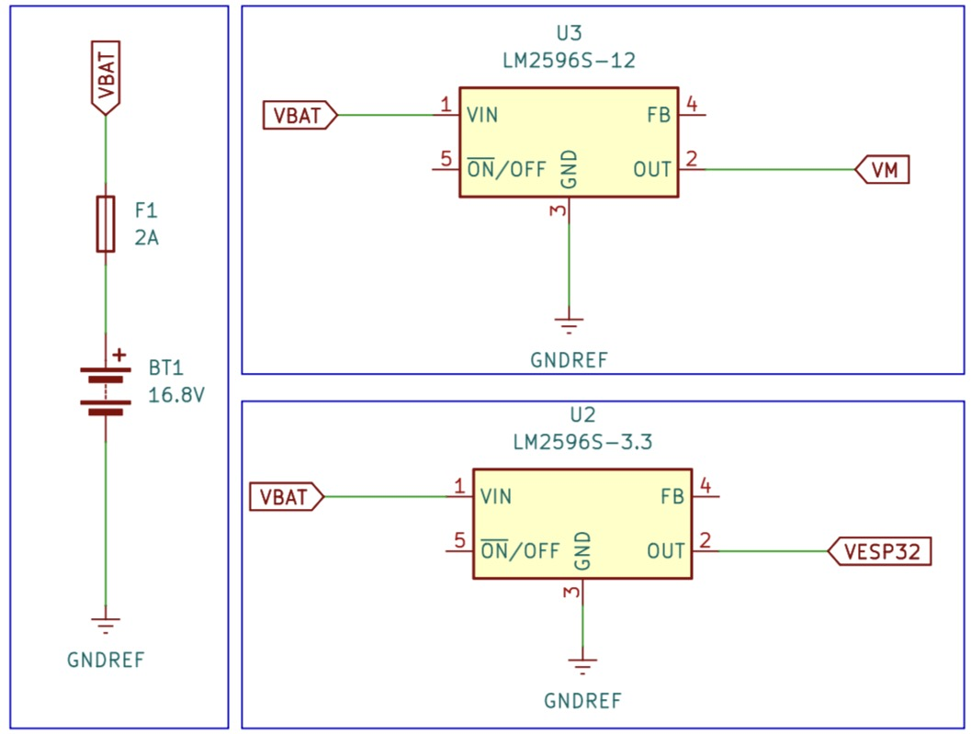
04 / Implementation
Schematic: Battery, Fuse, and Buck Supplies
VBAT + F1
Battery feed through
the 2 A reference fuse.
U2 / U3
Both converter branches
share GNDREF.
READ THE LABELS
Drawing: 3.3 V / 12 V.
Lab procedure: 5 V / 6 V.
Use adjustable modules for the lab setpoints; the original labels are shown unchanged.
Source: course PDF, pp. 9
DCLab/Control System Crash Course
34
>_ terminal gremlin (c-lydia ^_^)
Notes:
Reference: Power Architecture, Dual Buck Calibration, and Analog Battery Sensing.pdf, pages 9.

Slide 35
04 / Implementation
Schematic: ESP32 and Battery Sensing
R2 / R3
100 kΩ above VDIV;
22 kΩ below VDIV.
VDIV → D32
The divider midpoint
feeds GPIO 32 / ADC1.
LAB POWER INPUT
Connect the 5 V rail
to VIN, not to 3V3.
The shown 3V3 connection belongs to the drawing’s 3.3 V supply version.
Source: course PDF, pp. 8
DCLab/Control System Crash Course
35
>_ terminal gremlin (c-lydia ^_^)
Notes:
Reference: Power Architecture, Dual Buck Calibration, and Analog Battery Sensing.pdf, pages 8.

Slide 36
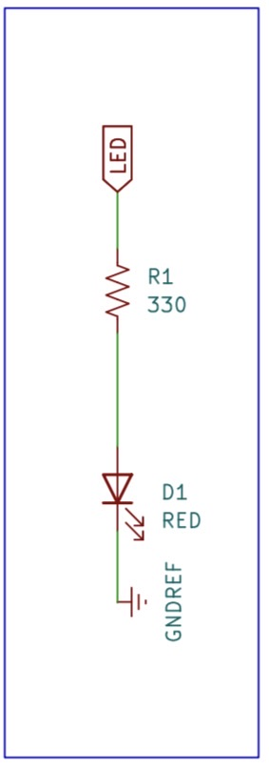
04 / Implementation
Schematic: PWM LED and Current Limiting
LED NET
The core drawing maps
this net to GPIO 18.
R1 = 330 Ω
Series resistor limits
current through D1.
D1 → GNDREF
Confirm LED polarity
and the return path.
This supplied image shows the PWM LED circuit; the heartbeat uses GPIO 4.
Source: course PDF, pp. 9
DCLab/Control System Crash Course
36
>_ terminal gremlin (c-lydia ^_^)
Notes:
Reference: Power Architecture, Dual Buck Calibration, and Analog Battery Sensing.pdf, pages 9.

Slide 37
04 / Implementation
Extend the Three-Rate Scheduler
MOTION
TELEMETRY
HEARTBEAT
100 Hz
10 Hz
1 Hz task
10 ms interval
Update PWM duty
and timing metrics.
100 ms interval
Read ADC, filter,
and report voltage.
1 second interval
Toggle the LED
on GPIO 4.
Hardware PWM continues at 20 kHz while the loop schedules tasks.
Source: course PDF, pp. 10, 13–17
DCLab/Control System Crash Course
37
>_ terminal gremlin (c-lydia ^_^)
Notes:
Reference: Power Architecture, Dual Buck Calibration, and Analog Battery Sensing.pdf, pages 10, 13–17.

Slide 38
04 / Implementation / Key Firmware 01 of 07
Configure the Battery Measurement
const uint8_t PIN_BATTERY_ADC = 32;
const float R_TOP_OHMS = 100000.0f;
const float R_BOTTOM_OHMS = 22000.0f;
const float DIVIDER_SCALE =
(R_TOP_OHMS + R_BOTTOM_OHMS) / R_BOTTOM_OHMS;
const float FILTER_ALPHA = 0.15f;
const float V_BAT_EMPTY = 12.0f;
Keep the pin, divider scale, filter coefficient, and warning threshold together.
Source: course PDF, pp. 10
DCLab/Control System Crash Course
38
>_ terminal gremlin (c-lydia ^_^)
Notes:
Focused teaching excerpt from the course PDF, pages 10. Uses the original identifiers; complete declarations, PWM, heartbeat, percentage calculation, and setup scaffolding are in the source PDF. Telemetry is reduced to the two voltage traces for plotting. The low-battery reporting snippet belongs inside the telemetry task in monitor mode.
const uint8_t PIN_BATTERY_ADC = 32;
const float R_TOP_OHMS = 100000.0f;
const float R_BOTTOM_OHMS = 22000.0f;
const float DIVIDER_SCALE =
(R_TOP_OHMS + R_BOTTOM_OHMS) / R_BOTTOM_OHMS;
const float FILTER_ALPHA = 0.15f;
const float V_BAT_EMPTY = 12.0f;

Slide 39
04 / Implementation / Key Firmware 02 of 07
Read Calibrated Battery Voltage
float readBatteryVoltage() {
const uint32_t pin_voltage_millivolts =
analogReadMilliVolts(PIN_BATTERY_ADC);
const float pin_voltage =
pin_voltage_millivolts / 1000.0f;
return pin_voltage * DIVIDER_SCALE;
}
Convert calibrated millivolts to volts, then undo the resistor divider.
Source: course PDF, pp. 11–12
DCLab/Control System Crash Course
39
>_ terminal gremlin (c-lydia ^_^)
Notes:
Focused teaching excerpt from the course PDF, pages 11–12. Uses the original identifiers; complete declarations, PWM, heartbeat, percentage calculation, and setup scaffolding are in the source PDF. Telemetry is reduced to the two voltage traces for plotting. The low-battery reporting snippet belongs inside the telemetry task in monitor mode.
float readBatteryVoltage() {
const uint32_t pin_voltage_millivolts =
analogReadMilliVolts(PIN_BATTERY_ADC);
const float pin_voltage =
pin_voltage_millivolts / 1000.0f;
return pin_voltage * DIVIDER_SCALE;
}

Slide 40
04 / Implementation / Key Firmware 03 of 07
Initialize the ADC and Prime the Filter
void initBatterySensing() {
pinMode(PIN_BATTERY_ADC, INPUT);
analogReadResolution(12);
analogSetPinAttenuation(PIN_BATTERY_ADC, ADC_11db);
raw_battery_voltage = readBatteryVoltage();
filtered_battery_voltage = raw_battery_voltage;
}
Call once in setup(); initialize the filtered state from a real sample.
Source: course PDF, pp. 12
DCLab/Control System Crash Course
40
>_ terminal gremlin (c-lydia ^_^)
Notes:
Focused teaching excerpt from the course PDF, pages 12. Uses the original identifiers; complete declarations, PWM, heartbeat, percentage calculation, and setup scaffolding are in the source PDF. Telemetry is reduced to the two voltage traces for plotting. The low-battery reporting snippet belongs inside the telemetry task in monitor mode.
void initBatterySensing() {
pinMode(PIN_BATTERY_ADC, INPUT);
analogReadResolution(12);
analogSetPinAttenuation(PIN_BATTERY_ADC, ADC_11db);
raw_battery_voltage = readBatteryVoltage();
filtered_battery_voltage = raw_battery_voltage;
}

Slide 41
04 / Implementation / Key Firmware 04 of 07
Filter and Check the Battery
void updateBatterySensing() {
raw_battery_voltage = readBatteryVoltage();
filtered_battery_voltage =
FILTER_ALPHA * raw_battery_voltage +
(1.0f - FILTER_ALPHA) * filtered_battery_voltage;
low_battery_flag =
filtered_battery_voltage < V_BAT_EMPTY;
}
Update the EMA and evaluate the warning against the filtered voltage.
Source: course PDF, pp. 12–13
DCLab/Control System Crash Course
41
>_ terminal gremlin (c-lydia ^_^)
Notes:
Focused teaching excerpt from the course PDF, pages 12–13. Uses the original identifiers; complete declarations, PWM, heartbeat, percentage calculation, and setup scaffolding are in the source PDF. Telemetry is reduced to the two voltage traces for plotting. The low-battery reporting snippet belongs inside the telemetry task in monitor mode.
void updateBatterySensing() {
raw_battery_voltage = readBatteryVoltage();
filtered_battery_voltage =
FILTER_ALPHA * raw_battery_voltage +
(1.0f - FILTER_ALPHA) * filtered_battery_voltage;
low_battery_flag =
filtered_battery_voltage < V_BAT_EMPTY;
}

Slide 42
04 / Implementation / Key Firmware 05 of 07
Report the Two Voltage Traces
void taskTelemetry() {
updateBatterySensing();
Serial.printf(
"V_bat_Raw: %.2f,V_bat_Filt: %.2f\n",
raw_battery_voltage, filtered_battery_voltage);
}
Focused plot output: compare the raw and filtered voltage at 10 Hz.
Source: course PDF, pp. 14
DCLab/Control System Crash Course
42
>_ terminal gremlin (c-lydia ^_^)
Notes:
Focused teaching excerpt from the course PDF, pages 14. Uses the original identifiers; complete declarations, PWM, heartbeat, percentage calculation, and setup scaffolding are in the source PDF. Telemetry is reduced to the two voltage traces for plotting. The low-battery reporting snippet belongs inside the telemetry task in monitor mode.
void taskTelemetry() {
updateBatterySensing();
Serial.printf(
"V_bat_Raw: %.2f,V_bat_Filt: %.2f\n",
raw_battery_voltage, filtered_battery_voltage);
}

Slide 43
04 / Implementation / Key Firmware 06 of 07
Report the Low-Battery Condition
if (low_battery_flag) {
Serial.println(
"[ALARM] LOW BATTERY VOLTAGE BELOW 12.0 V"
);
}
Add inside the telemetry task for Serial Monitor use; omit text alarms while plotting.
Source: course PDF, pp. 14–15
DCLab/Control System Crash Course
43
>_ terminal gremlin (c-lydia ^_^)
Notes:
Focused teaching excerpt from the course PDF, pages 14–15. Uses the original identifiers; complete declarations, PWM, heartbeat, percentage calculation, and setup scaffolding are in the source PDF. Telemetry is reduced to the two voltage traces for plotting. The low-battery reporting snippet belongs inside the telemetry task in monitor mode.
if (low_battery_flag) {
Serial.println(
"[ALARM] LOW BATTERY VOLTAGE BELOW 12.0 V"
);
}

Slide 44
04 / Implementation / Key Firmware 07 of 07
Schedule Battery Sensing at 10 Hz
if ((uint32_t)(current_time_ms - last_telemetry_time_ms)
>= INTERVAL_TELEMETRY_MS) {
last_telemetry_time_ms += INTERVAL_TELEMETRY_MS;
taskTelemetry();
}
Inside loop(): a 100 ms interval, independent of motion and heartbeat timing.
Source: course PDF, pp. 17
DCLab/Control System Crash Course
44
>_ terminal gremlin (c-lydia ^_^)
Notes:
Focused teaching excerpt from the course PDF, pages 17. Uses the original identifiers; complete declarations, PWM, heartbeat, percentage calculation, and setup scaffolding are in the source PDF. Telemetry is reduced to the two voltage traces for plotting. The low-battery reporting snippet belongs inside the telemetry task in monitor mode.
if ((uint32_t)(current_time_ms - last_telemetry_time_ms)
>= INTERVAL_TELEMETRY_MS) {
last_telemetry_time_ms += INTERVAL_TELEMETRY_MS;
taskTelemetry();
}

Slide 45
04 / Implementation
Bench Test: Meter, Monitor, Plotter
Measure
Probe the battery terminals and GPIO 32.
Compare with the expected voltages on the next slide.
Observe
At 115200 baud, expect 10 samples per second.
Plot raw and filtered voltage together.
Compare
Aim for agreement within ±0.10 V at the pack
after checking divider values and calibration.
Treat ±0.10 V as the lab target, not a guaranteed ADC specification.
Source: course PDF, pp. 17–18
DCLab/Control System Crash Course
45
>_ terminal gremlin (c-lydia ^_^)
Notes:
Reference: Power Architecture, Dual Buck Calibration, and Analog Battery Sensing.pdf, pages 17–18.

Slide 46
04 / Implementation
Expected Bench Measurements
FULL PACK
NOMINAL PACK
WARNING LEVEL
16.80 V
14.80 V
12.00 V
Divider midpoint
≈ 3.030 V
Divider midpoint
≈ 2.669 V
Divider midpoint
≈ 2.164 V
The filtered value should settle near the meter reading.
Source: course PDF, pp. 5, 18
DCLab/Control System Crash Course
46
>_ terminal gremlin (c-lydia ^_^)
Notes:
Reference: Power Architecture, Dual Buck Calibration, and Analog Battery Sensing.pdf, pages 5, 18.

Slide 47
04 / Implementation
Debugging: Wrong Voltage
Reads zero
Check the divider midpoint connection,
GPIO number, ground path, and resistor joints.
Wrong scale
Verify 100 kΩ / 22 kΩ orientation, measured
resistor values, and the 5.54545 scale factor.
Clips near full
Check attenuation and the chip input range;
compare the physical midpoint voltage first.
Measure the signal chain in order: pack → divider → ADC → software.
Source: course PDF, pp. 18
DCLab/Control System Crash Course
47
>_ terminal gremlin (c-lydia ^_^)
Notes:
Reference: Power Architecture, Dual Buck Calibration, and Analog Battery Sensing.pdf, pages 18.

Slide 48
04 / Implementation
Debugging: Noise, Lag, and Alarms
Noisy voltage
Inspect motor return routing and connections.
Reduce α if smoothing is insufficient.
Slow tracking
Increase α cautiously from 0.15 toward 0.3;
confirm the sampling interval is still 100 ms.
Alarm on startup
Compare raw and filtered sag with a meter
or scope; check battery and wiring impedance.
Do not hide persistent undervoltage by adding more filtering.
Source: course PDF, pp. 18–19
DCLab/Control System Crash Course
48
>_ terminal gremlin (c-lydia ^_^)
Notes:
Reference: Power Architecture, Dual Buck Calibration, and Analog Battery Sensing.pdf, pages 18–19.

Slide 49
04 / Implementation
Lab Completion Checklist
Power verified
5 V logic and 6 V motor rails measured
with correct polarity and separate outputs.
Sensing verified
Divider midpoint and reconstructed pack
voltage agree with physical measurements.
Software verified
Stable 10 Hz telemetry, primed EMA,
and the low-voltage condition understood.
Explain each measurement before moving to motor control.
Source: course PDF, pp. 7, 17–19
DCLab/Control System Crash Course
49
>_ terminal gremlin (c-lydia ^_^)
Notes:
Reference: Power Architecture, Dual Buck Calibration, and Analog Battery Sensing.pdf, pages 7, 17–19.

Slide 50
>_ KEEP EXPLORING ^_^
References / 1 of 2
01
The Art of Electronics: Student Manual
Thomas C. Hayes and Paul Horowitz
02
Making Embedded Systems: Design Patterns for Great Software
Elecia White
03
Feedback Systems: An Introduction for Scientists and Engineers
Karl Johan Åström and Richard M. Murray
04
ADC Peripheral API Documentation — Espressif Systems
Source: course PDF, pp. 19
DCLab/Control System Crash Course
50
>_ terminal gremlin (c-lydia ^_^)
Notes:
Exact links supplied in the course notes:
https://physics.bu.edu/adlab_and_elab/wp-content/uploads/2023/03/Thomas-C.-Hayes-Paul-Horowitz-The-Art-of-Electronics-Student-Manual-Cambridge-University-Press-1989.pdf
https://github.com/VaheDanielyan/UsefulBooks/blob/master/Elecia%20White%20-%20O'Reilly%20Making%20Embedded%20Systems%20(2011).pdf
https://www.cds.caltech.edu/~murray/books/AM08/pdf/am08-complete_22Feb09.pdf
https://docs.espressif.com/projects/arduino-esp32/en/latest/api/adc.html

Slide 51
>_ KEEP EXPLORING ^_^
References / 2 of 2
05
GPIO Peripheral API Documentation — Espressif Systems
06
Espressif Centralized Documentation Platform (CDP)
07
Arduino Core for ESP32 Documentation — Espressif Systems
08
Arduino Language Reference — Arduino
Source: course PDF, pp. 19
DCLab/Control System Crash Course
51
>_ terminal gremlin (c-lydia ^_^)
Notes:
Exact links supplied in the course notes:
https://docs.espressif.com/projects/arduino-esp32/en/latest/api/gpio.html
https://documentation.espressif.com/en/documentList?eol=false
https://docs.espressif.com/projects/arduino-esp32/en/latest/index.html
https://docs.arduino.cc/language-reference/

Slide 52
SESSION 03 / POWER ARCHITECTURE & ADC
Thank you!
Questions & discussion
+
4S battery
100 kΩ
ADC → EMA
−
22 kΩ
POWER
SENSE
FILTER
DCLab/Control System Crash Course
52
>_ terminal gremlin (c-lydia ^_^)

